Slide 1
Heart Failure Supportive Care in 2016
GIL KIMEL MD, MSC, FRCPC
Dept. of Medicine
Division of Palliative Care

Slide 2
Disclosures

Slide 3
Objectives
Concept of Palliative Care
Heart Failure Supportive Care
Heart Failure Supportive Care Clinic (HFS)

Slide 4
Palliative Medicine
Palliative – Palliare (Latin) – to cloak
Approach to improve QoL of pts. and families facing life- threating illness
Physical, psychosocial, spiritual

Slide 5
Palliative Medicine
“What has surprised me is how little palliative care has to do with death. The death part is almost irrelevant. Our focus isn’t on dying. Our focus is on quality of life”
Dr. Balfour Mount
McGill University

Slide 6
Case
80 female presenting to ED with SOB
PmHX: CHF – NYHA III, DM, 25 PY smoker
3 yrs ago… large anterior wall MI
In last 2 years:
7 admissions to CTU decompensated HF
Poorly compliant with diet, fluid and exercise

Slide 7
Case
History:
Symptoms: SOB at rest (NYHA IV)
Exercise tolerance – 5 feet; + orthopnea/PND; no CP; poor sleep ; ESAS >65
Compliance: Poor fluids /salt restriction
Medication: ASA, ACEi, BB, Statin, Lasix, Aldactone, Warfarin, Insulin, Allopurinol
Exam: BP 84/60, HR 88, O₂ Sats 92% (6 L HF), T: 36.9
JVP Angle of Jaw, Crackles throughout, peripheral edema, ascites, S1, S2 normal, cool extremities

Slide 8
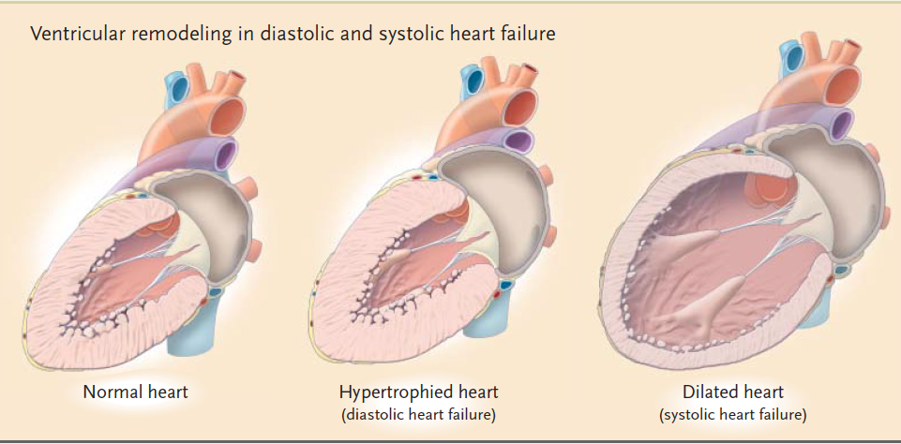
Heart Failure
Inability of heart to meet metabolic demands of body
Jessup , NEJM 2003

Slide 9
Heart Failure - Reality
Impacts QoL and length of life
High health care costs ~ $2 billion/ year in Canada
25,000 deaths / year in Canada
QoL in NYHA III/IV … ‘trade’ ½ of remaining life to feel better
Krum 2009, Lewis 2001
Notes:
----- Meeting Notes (13-01-22 22:12) -----
highlights how much it can impact QoL

Slide 10
Heart Failure
Only cardiac syndrome rising in prevalence
Survival rate for HF ≈ Malignancy :
1 yr = 66%
2 yr = 50%
5 yr = 35%
Compared to malignancy :
Less palliative care
Less likely to understand their illness
Less likely to plan for death
More likely to die in hospital
Johnson Postgrad Med 2007; Yeung CMAJ 2012
Notes:
Interpretation: The incidence of heart failure decreased substantially during the study period. Nevertheless, the prognosis for patients with heart failure remains poor and is associated with high mortality. 1997 - 2008

Slide 11
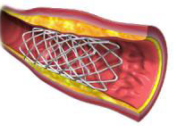
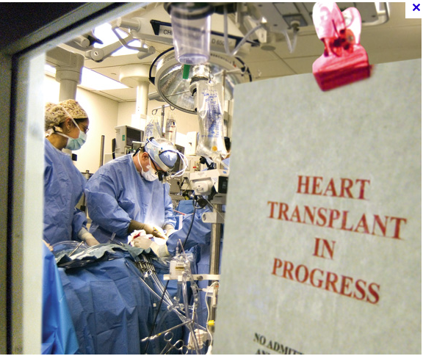
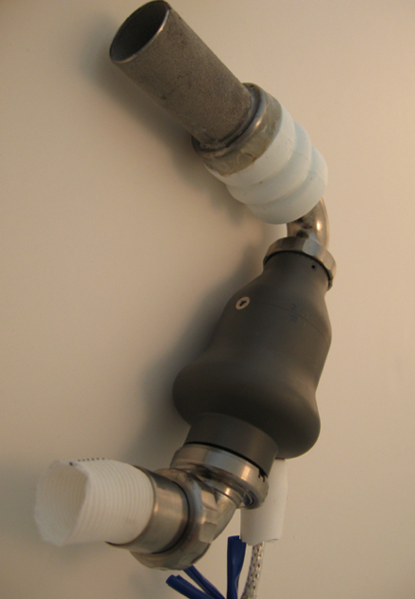
Heart Failure
Medication decreases morbidity and mortality
ACE-I, ββ, spironolactone
Treatments are palliative
PCI, TAVI, LVAD

Slide 12
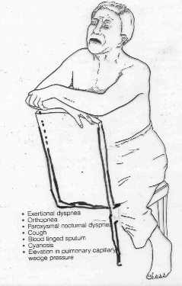
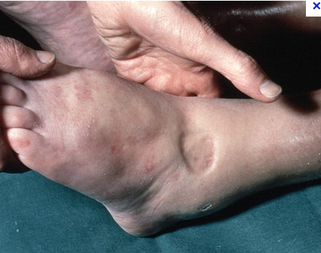
Heart Failure
Patients often have symptoms early
Symptoms affect daily activities, work, relationships
2005 ACC / AHA: class 1 recommendations for inclusion of Palliative Medicine in heart failure treatment

Slide 13
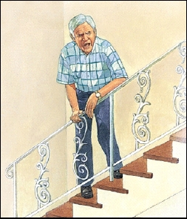
Heart Failure
NYHA Functional Class: Mortality 1 yr
Class I –Without symptoms 5-10%
Class II – Symptoms ordinary activity 15-30%
Class III – Symptoms < ordinary activity 15-30%
Class IV – Symptoms at rest 50-60%
Taylor 2003

Slide 14
Heart Failure – Palliative Care
Only ~ 10-15% of pts with HF receive palliative care
Evidence for Palliative Care in HF less than for Cancer
CHF differences from Cancer:
Prognostication more difficult
Thought to be more benign
Pt feels unwell told “doing well”
Feel better on treatment
Murray BMJ 2002; O’Brien BMJ 1998, Goldstein 2012

Slide 15
HF Symptom Prevalence
SOB 60-88%
Fatigue 69%
Nausea 48%
Depression 9-36%
Insomnia 36-48%
Anxiety 49%
Confusion 18-32%
Constipation 38-42%
Edema 44%
Dizziness 21%
Pain 41-77%
JP Solano 2006
Notes:
Other diseases cancer AIDS HD COPD RF have similar symptoms

Slide 16
Characterize survival on HF admissions
BC cohort >14,000 patients
Survival time measured after first and each hospitalization
Number of CHF hospitalization = strong predictor of mortality
Setoguchi AHJ 2007

Slide 17
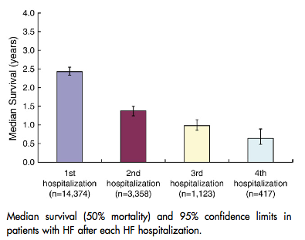
Survival Decreases with Repeated Hospitalizations
Setoguchi AHJ 2007

Slide 18
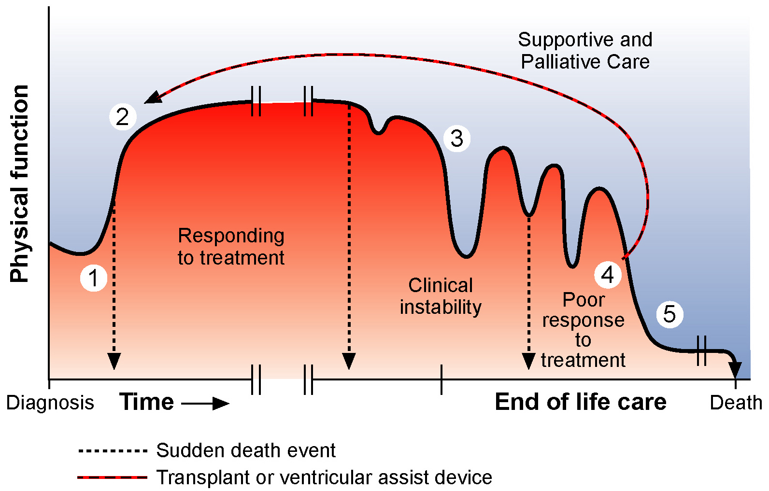
Phases of HF
Goodlin JACC. 2009;54:386-396

Slide 19
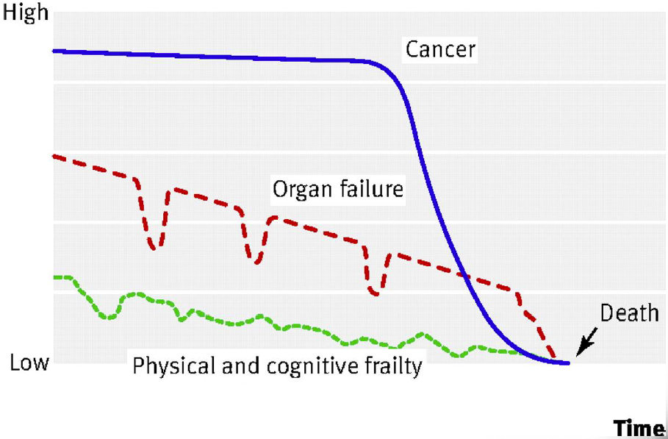
Trajectories at End-of-Life
Jaarsma presentation; British Medical Journal 2008
Notes:
----- Meeting Notes (13-01-21 21:34) -----
with organ failure PCU can be involved in multiple places, not just phase 5

Slide 20
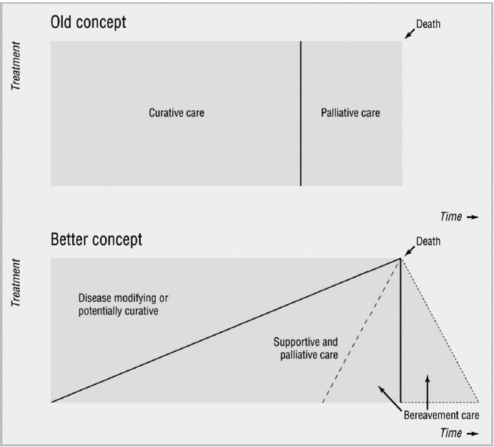
Transition to Palliative Care
X
Murray 2007

Slide 21
? Better Model → Concurrent Care
NYHA CLASS III
Standard Heart Failure Treatment
Palliative Care

Slide 23
Did I tell patient what’s coming?
http://palliative.info/pages/TeachingMaterial.htm

Slide 24
Back to Case
Improve patient comfort
IV Lasix, immediate opioids, possibly oxygen
Communicate with patient and family
Discuss options and prognosis
Make recommendations
? 2 options:
Admit to CCU or Medicine and try aggressive diuresis

Slide 25
Heart Failure Supportive Care Clinic (HFS)
Established in January 2011 at St. Paul’s Hospital / VGH
Pilot Project - Hypothesis

Slide 26
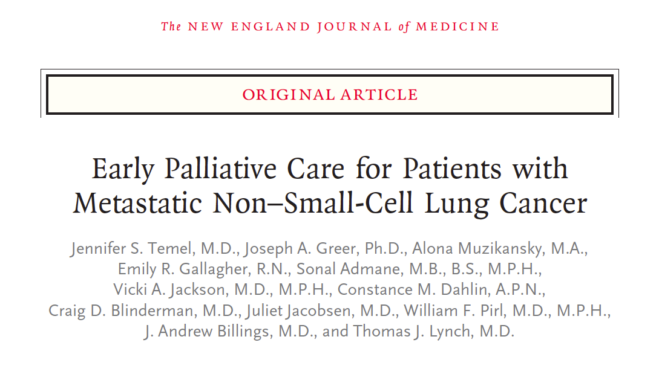
Heart Failure Supportive Care Clinic (HFS)
Clinic Concept → Dr. Temel’s Study NEJM

Slide 27
Newly diagnosed metastatic NSCLC (n =151)
Randomized to:
Early palliative care & standard oncology care
Standard oncology care
Primary outcome: QoL and Mood at 12 weeks
QoL measured by FACT – L
Mood measured by Hospital Anxiety and Depression Scale
Temel, NEJM, 2010
Notes:
FACT – L : Functional assessment of caner therapy

Slide 28
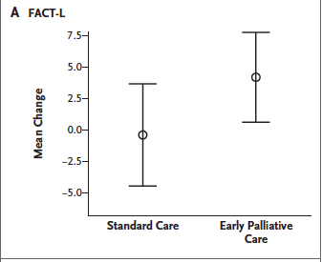
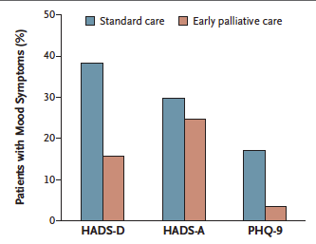
Quality of Life
Mood
Temel, NEJM, 2010

Slide 29
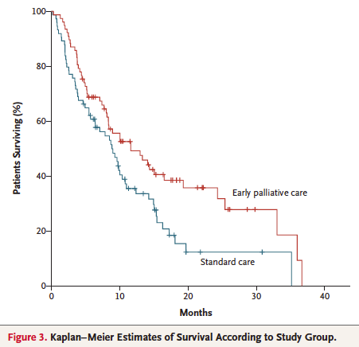
Temel, NEJM, 2010

Slide 30
Heart Failure Supportive Care Clinic (HFS)
Combines specialties of cardiology and palliative care
Out-patients
Patients referred by cardiologists
Patients not usually candidates for transplant or LVAD
All patients are very complex medical patients
Advanced Heart Failure – NYHA III or IV
All have multisystem disease
ALL have moderate to severe symptoms
Based on ESAS
Notes:
Facit – functional assesment of chronic illness therapy

Slide 31
Heart Failure Supportive Care Clinic (HFS)
Goal of Clinic:
Assess and treat: SOB, Fatigue, Constipation, Anxiety, Insomnia
Polypharmacy
ICD deactivation
Advance Care Planning
BC Palliative Care Benefits & Home DNR
Hospice
To help patient understand complex trajectory

Slide 32
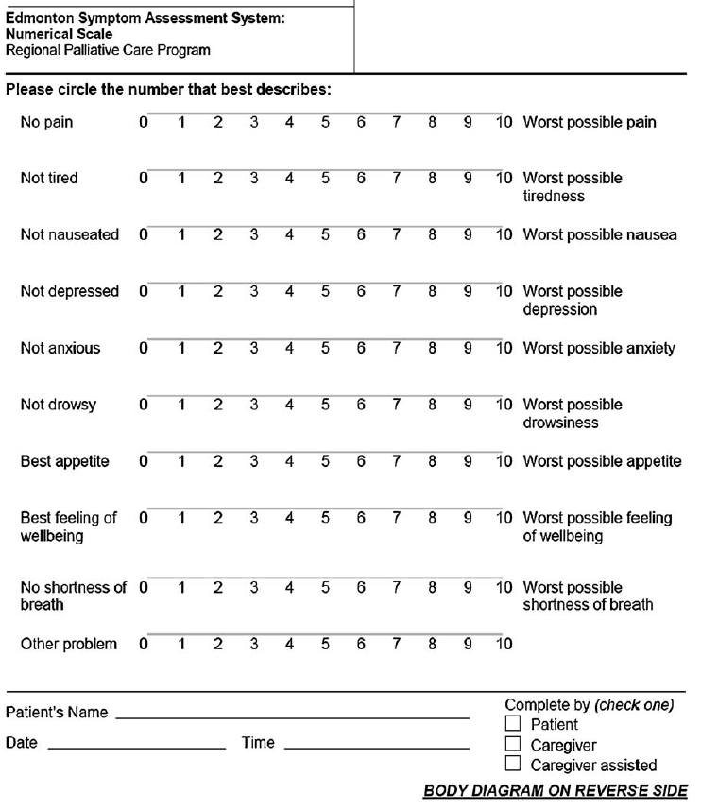
Results: ESAS Scores
Compared first ESAS score to most recent
64% improved
13% stable
Mean improvement: 5.1 points
SOB & overall well-being most improved

Slide 33
Results: Medications
Average medications at first visit: ~10
16 patients had medication reduction without symptoms
Commonly discontinued meds:
Atorvastatin
Simvastatin
Zopliclone
Amlodipine

Slide 34
Conclusions
First study to evaluate HeF Clinic
Data shows that it has a positive impact on several quality of life measures
Results consistent with known high mortality of CHF

Slide 35
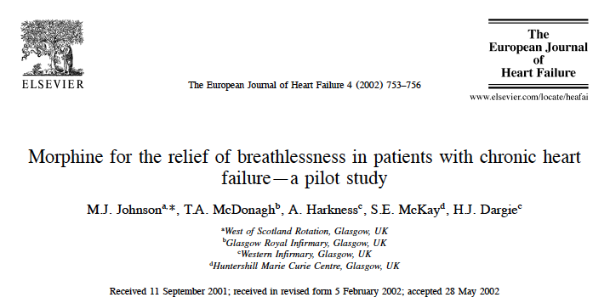
10 out-patient NYHA III/IV RCT
4 days of 5mg of morphine vs. placebo
Results: 6/10 patients reported decreased SOB

Slide 36
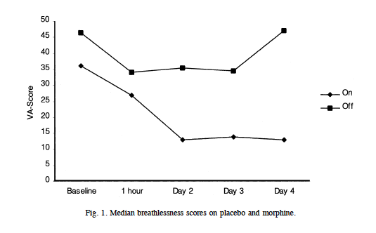
On Morphine:
Breathlessness score fell
Sedation not significant by day 4
No significant differences in other measure (nausea, BP, HR)

Slide 37
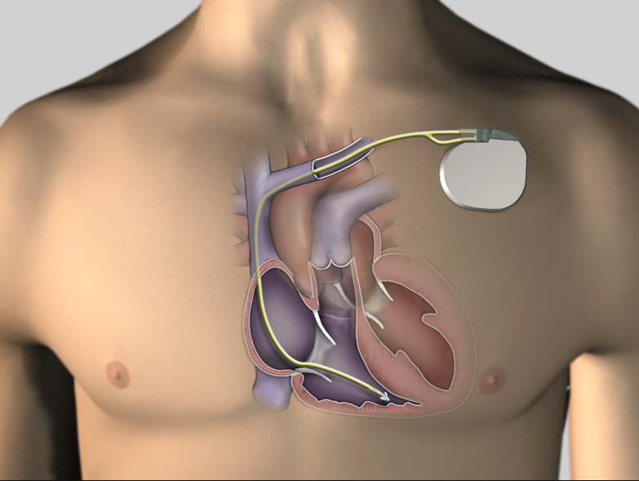
ICD – Implantable Cardioverter -Defibrillator

Slide 38
ICD Deactivation
Poor Communication on ICD deactivation
> 95% of hospices admit pts with active ICDs
> 50% of hospices have had pts shocked
~ 42% of pts have shocking function deactivated
73% no discussion of turning off ICDs
Goldstein 2004, 2010

Slide 39
ICD Deactivation
Physicians uneasy talking about ICD deactivation
Patients don’t want to talk about it either
Physicians should advocate for patient
Lampert 2010

Slide 40
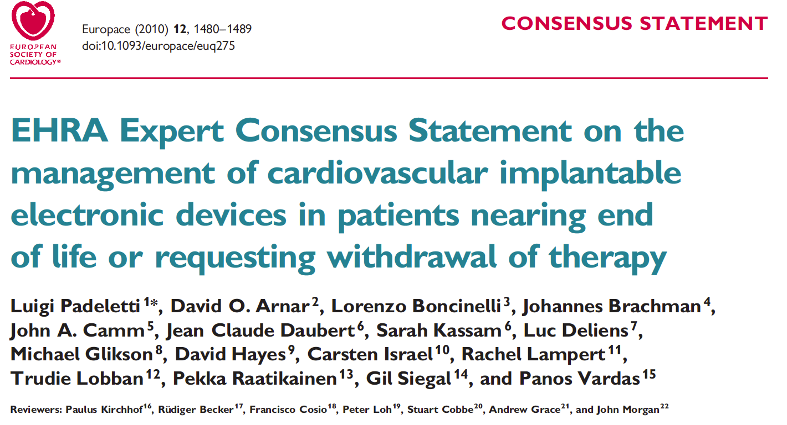
ICD Deactivation
Last weeks of life: 20% receive shocks
Notes:
In last weeks of life: 20% rec shocks
Shocks are painful, decrease QoL, greatly contribute to distress of of patients and families.

Slide 41
Title: Palliative Care on the Heart Failure Team: Mapping Patient and Provider Experiences and Expectations
Multicenter: Western, Dalhousie, UBC
Data collection –completed

Slide 42
Objectives
Factors that influence palliative care integration
Systems of communication
Identify opportunities for improved integration of palliative care

Slide 43
Thank you
UBC Cardiology Team - Dr. Andy Ignaszewski
Nursing team – Annemarie, Ella, Cindy, Dianne, Erin, Linda
Frances Simpson & Tom Hahn
Email: gkimel@providencehealth.bc.ca

Slide 44
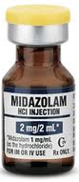
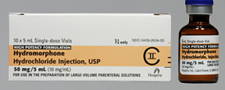
Suggestions for CHF Meds
Opioids: Depending on severity of Dyspnea, pain, and age
Requires frequent reassessment
Hydromorphone: 1Mg SC q 4 hr regular
Hydromorphone: 1Mg SC q 1 hr PRN for dyspnea
Recalculate q4 hr dose every 1-2 days
Based on previous 24 hr useage
Midazolam: 1-2 Mg SC q 2 hrs PRN for worsening SOB
Nozinan: 2.5 – 5 Mg SC q 3 hrs PRN for agitation

