Slide 1
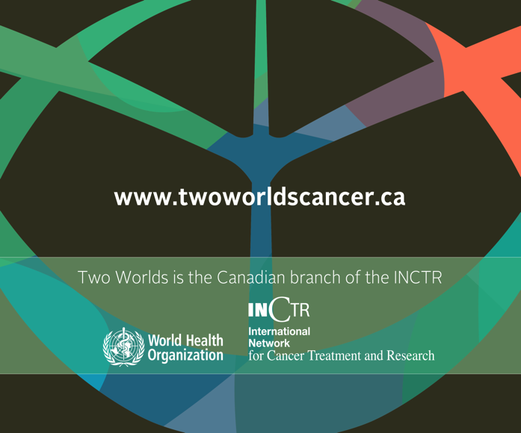
PALLIATIVE CARE FOR CHILDREN IN SOUTH ASIA
DR GAYATRI PALAT

Slide 2
South Asian Countries
Afghanistan, Bangladesh, Bhutan, Maldives, Nepal, India, Pakistan and Srilanka
1/4rth of world population
Many ancient cultures, diverse religions and beliefs
Some broad similarities

Slide 3
Childhood Cancers
80% children with cancer live in low‐ and middle‐income countries
A rising trend in India and ninth common cause of deaths among children between 5 and 14 years
Each year 200,000 children are diagnosed with cancer and only about 25% survive
Summary – Report on Causes of Death: 2001‐03 in India. Available from: http://www.censusindia.gov.in/Vital_Statistics/Summary_Report_ Death_01_03.pdf
Kellie SJ, Howard SC. Global child health priorities: What role for paediatric, oncologists? Eur J Cancer 2008;44:2388‐96.
Notes:
Treatment of childhood cancers is one of the major successes of modern medicine

Slide 4
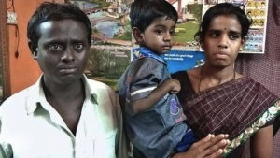
Fallen Angels – Mahesh’s Story
Photograph courtsey, The Hindu

Slide 5
“Man seeks euthanasia for son”
The Hindu CHITTOOR: AUGUST 14, 2016
Denied the request
The little boy diagnosed with a cancer Family took him to major cities for treatment, sold everything, in debt of a prohibitive amount of Rs 15,00,000 ( $22,500)
He suffered from debilitating pain and suffering and cried constantly
Unrelenting anguish to the family
Notes:
He was denied this request.
According to the article, the little boy, Mahesh, was diagnosed with cancer a few weeks after he was born. The family took him to some of the major cities of southern India – Chennai, Hyderabad, Vellore and Bangalore – seeking help and treatment. They racked up a debt of 15,00,000 rupees (the equivalent of approximately $22,500) – a prohibitive amount for anybody in a developing country. A devastating amount for a family whose only breadwinner works as a barber in a village.
Each of these cities has established pain and palliative care centers. Yet, no referrals were made to them. Mahesh suffered unnecessary, debilitating pain. He cried constantly, causing his family unrelenting anguish. At the end of 4 years, the family had sold everything they owned, with no resulting benefit to the child.

Slide 6
…Mahesh
On reading this article, a desperate attempt to track down the family
After 48 hours the family was found in Bangalore, little Mahesh in an ICU, bleeding from multiple places and in pain
Despite our best efforts, Mahesh died hooked up to machines, far from home, in unyielding and unspeakable pain, watched by his horrified parents
He had completed his 5th birthday just the
day before
Notes:
frantic networking was done in
A counselor made an overnight bus journey carrying essential opioids while other avenues were explored locally

Slide 7
…Mahesh
This is not a story about the pros and cons of euthanasia – a concept hotly debated in our country
But a story about the unforgivable failure on the part of the healthcare system to address the boy’s pain in the absence of curative treatment options.

Slide 8
Population-1.21 Billion
(17% of world population)
50% below 25 years
Jammu & Kashmir
Himachal
Pradesh
Ludhiana
Punjab
Chandigarh
Uttaranchal
Haryana
Delhi
Arunacha
Pradesh
Digboi
Rajasthan
Jaipur
Uttar Pradesh
Assam
Gauhati
Bihar
Madhya Pradesh
Jharkhand
Gujarat
Indore
Calcutta
Chhattisgarh
Orissa
West
Bengal
Maharashtra
Cuttack
Mumbai
Less than 1% have access to Palliative Care
Pune
Hyderabad
ANDHRA
PRADESH
Goa
Karnataka
Bangalore
Chennai
Kerala
Lakshadweep
Calicut
Coimbatore
Trichur
Tamil
Nadu
Malappuram
Andaman & Nicobar Islands
Alleppey
Map not to scale
Trivandrum
Notes:
India youngest country by 2020

Slide 9
Pediatric Palliative Care in India
Palliative care programs specially designed to address the needs of children are few and far between
Most programs are provided by generalist palliative care who are not exclusively involved in pediatric palliative care but who have specific skills

Slide 10
Pediatric Palliative care in India
According to Global Atlas of Palliative Care, India has attained level two integration, i.e., sporadic distributions of services for provision of pediatric palliative care
WHO Global Atlas on Palliative Care at the End of Life; 2014. Available from: http://www.thewhpca.org/resources/global‐atlas‐on‐end‐of‐life‐care.

Slide 11
Specialist Pediatric Palliative Care Referral Practices in Pediatric Oncology: A Large 5-year Retrospective Audit
Oncologists referred patients late in the course of disease trajectory
Most of the referrals were made for counseling and communication,
Many patients had high symptom burden during referral
Arunangshu Ghoshal et al., Indian Journal of Palliative Care /
Jul-Sep 2016 / Vol 22 / Issue 3
Notes:
Retrospective review of medical case records of pediatric palliative care
patients over a period of 5 years from January 1, 2010 to December 31, 2014. Descriptive summaries of demographic, clinical variables, and patient circumstances at the time of referral and during end-of-life care were examined.
Results: A total of 1135 patients were referred from pediatric oncology with a gradual increasing trend over 5 years. About 84.6% consultations took place in the outpatient setting. In 97.9% of the cases, parents were the primary caregivers. Availability of specialist pediatric health-care services at local places was available in 21.2% cases and 48% families earned <5000 INR (approximately 73 USD) in a month. Around 28.3% of the referrals were from leukemia clinic and maximum references were late with 72.4% patients having advanced disease at presentation. 30.3% of the referrals were made for counseling and communication and 54.2% had high symptom burden during referral. After referral, 21.2% patients continued with oral metronomic chemotherapy and 10.5% were referred back to oncology services for palliative radiotherapy. Only 4.9% patients had more than 2 follow-ups. 90.8% of the patients were cared for at home in the last days of illness by local general practitioners. 70.6% of the deaths were anticipated.

Slide 12
Integrating Palliative Care into a Pediatric Oncology Service in a Tertiary Cancer Hospital –
An Indian Experience

Slide 13
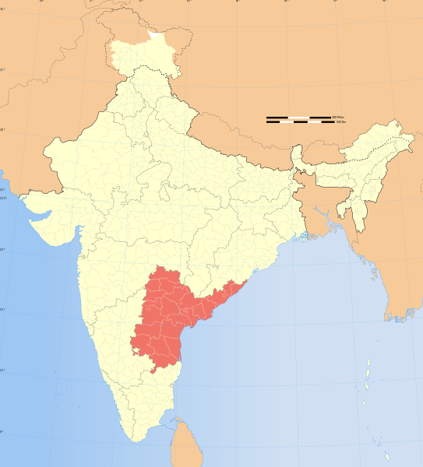
MNJ Institute of Oncology, Hyderabad, India
A tertiary care cancer hospital
Caters to 84 million population

Slide 14
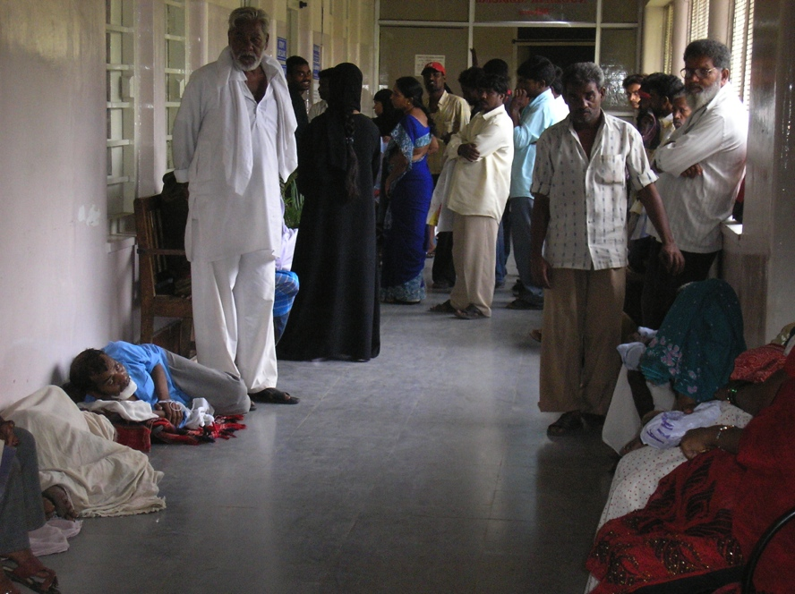
Department of Palliative Care, MNJ Institute of Oncology
One of the regional centers in India for quality clinical services, training and advocacy and research

Slide 15
Gaps Identified
1000 children with cancer / year
Low Cure Rates < 20%
High Treatment Abandonment

Slide 16
…Gaps Identified
Children require long, intensive curative treatment
Painful procedures, various symptoms
Emotional trauma and exhaustion
Families often travel long distances and stay in the hospital for weeks together
Notes:
Emotional trauma of facing a potentially life threatening illness

Slide 17
“If you send me home, they will never bring me back”
Firdous, a 12 year old girl with Osteosarcoma
Existing socio-economic conditions render some children vulnerable and more at risk to abuse, exploitation and neglect.

Slide 18
Total Suffering
Social
Physical
Spiritual
Emotional

Slide 19
Integrated Pediatric Palliative Care Approach in MNJ IO-2007
  To incorporate palliative care into the care of the child right from the time of diagnosis
  Zero-tolerance to pain – every effort to keep a child pain free

Slide 20
Integrated Palliative Care
Child with Cancer
Curative Care
Palliative Care Only
Palliative Therapy
Palliative Coordinator and Medical Oncology team

Slide 21
Integrated Palliative Care
Palliative Care only
End of Life care
Palliative Treatment
Symptomatic Treatment
Cure
Curative Therapy

Slide 22
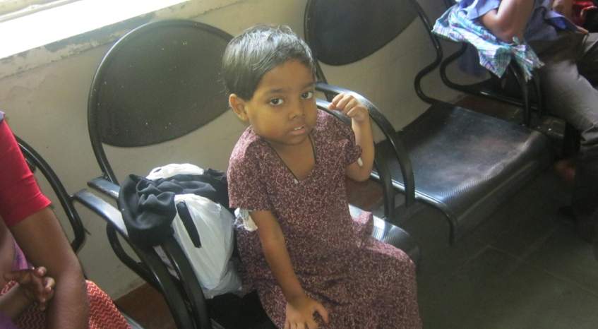
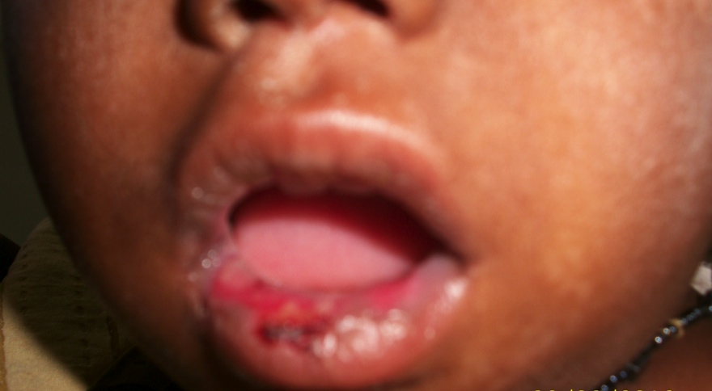
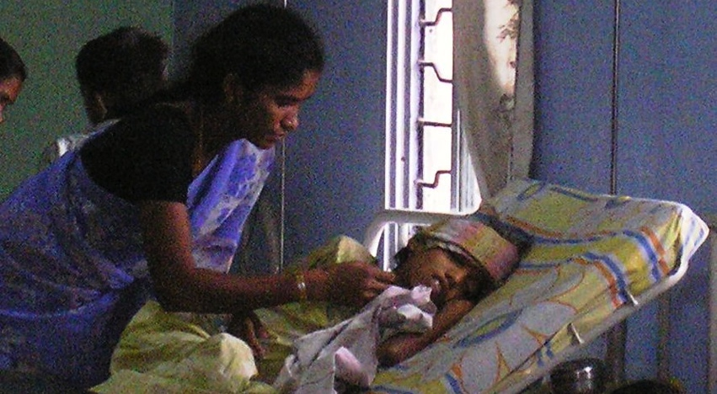


Slide 23
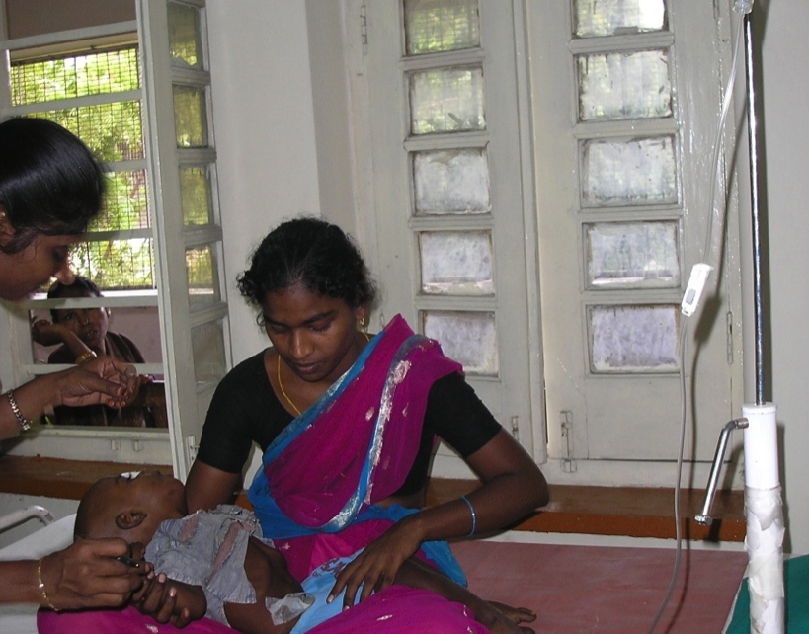
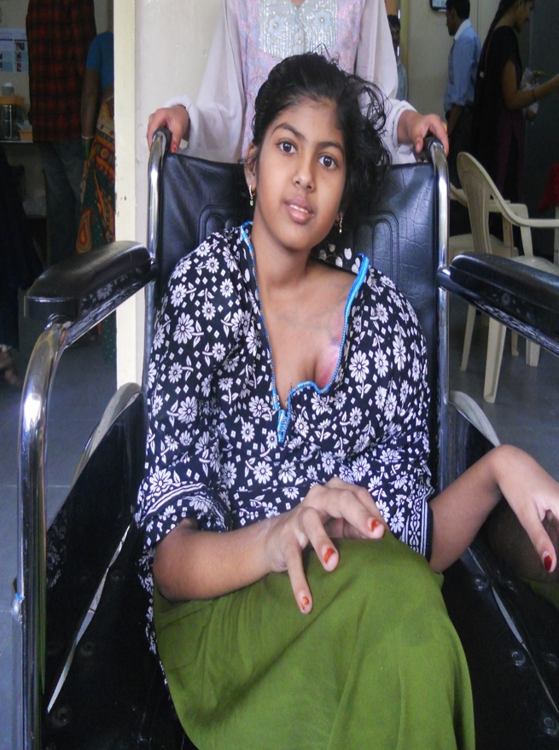

Slide 24
Pediatric Pain and Palliative Care
Pain & Symptom Relief
Support Groups for Families
Psychosocial Support , Recreation and Rehabilitation
End of Life Care
Bereavement Support
Procedure Related Pain
24 Hours Phone consult

Slide 25
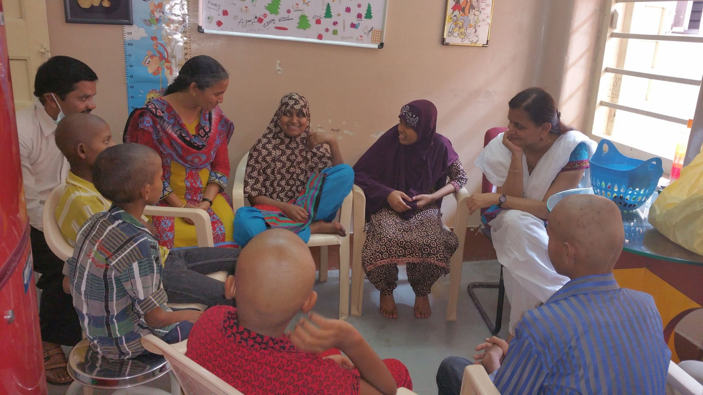
Children Support Group

Slide 26
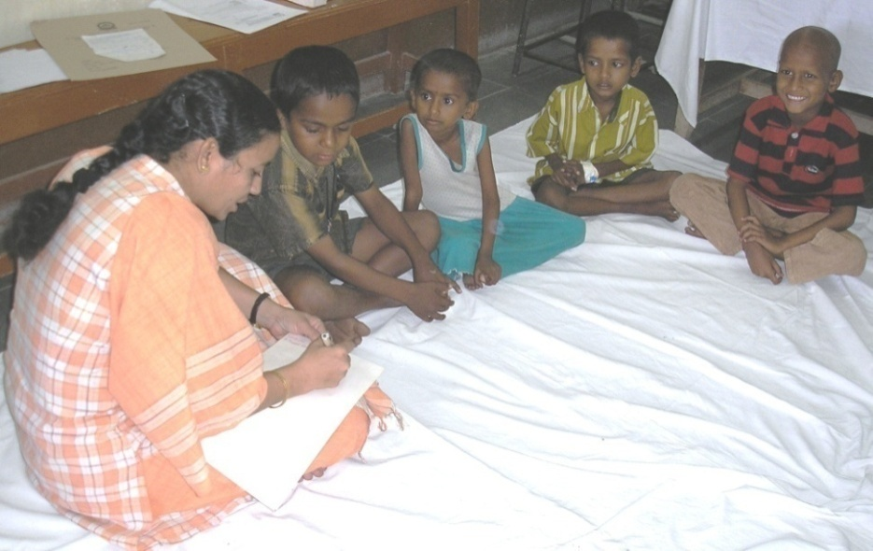
Concerns of Children
Most detested invasive procedures and Number of pills.
Going back to their daily routine
  Playing with their siblings or friends
  Food cooked at home
  Watching TV
  Missing going to
  school

Slide 27
…Play therapy
A pilot project to incorporate play therapy into the Pediatric Palliative Care Program
A certified play therapist and her interns work with the children in the ward

Slide 28
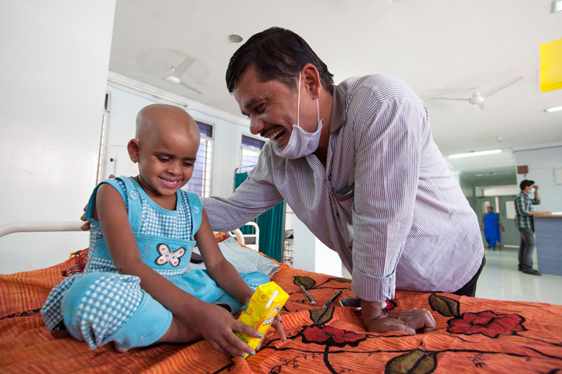
Play therapy
This is the way they make sense of their life experiences.
Adults talk; children play it out!
It helps growth and development on an emotional and psychological level and they learn their socialization skills
Sickness
They act out feelings or actions that scare, anger or hurt them, and work out solutions
Activates the child’s innate self-healing
abilities

Slide 29
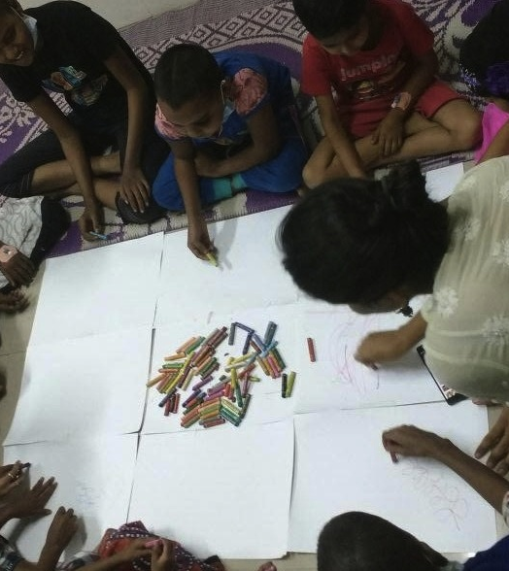
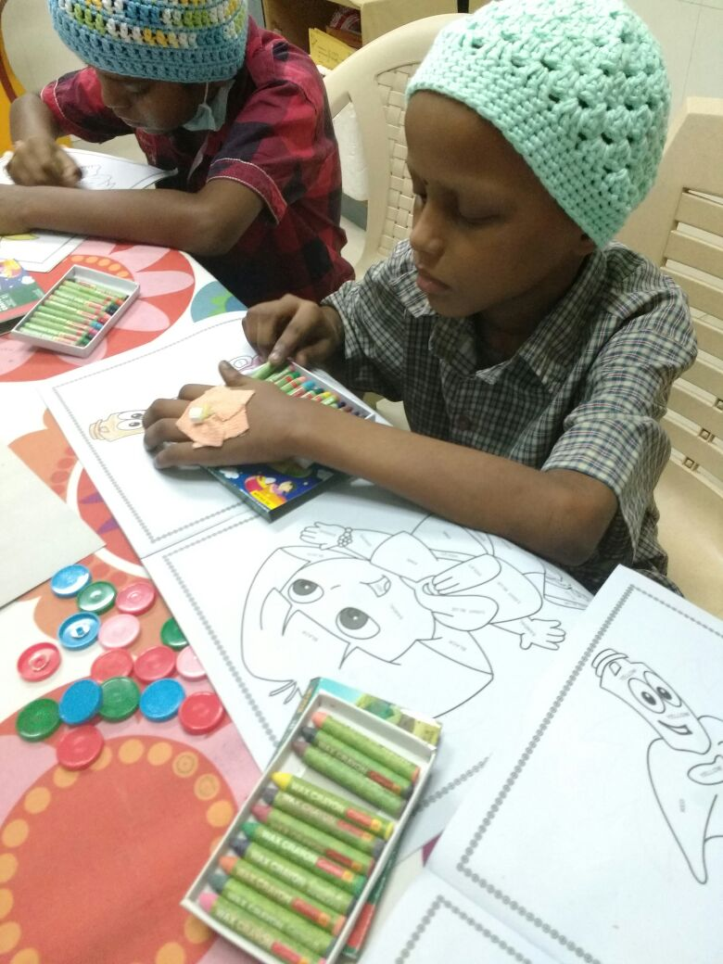
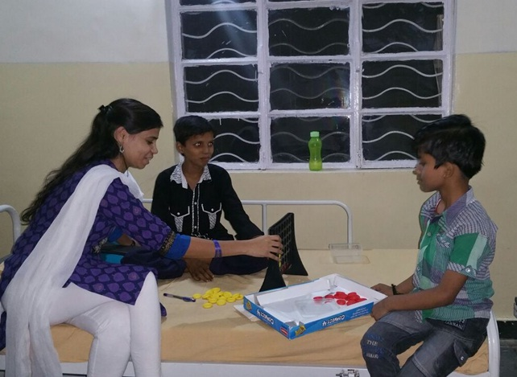
Play therapy

Slide 30
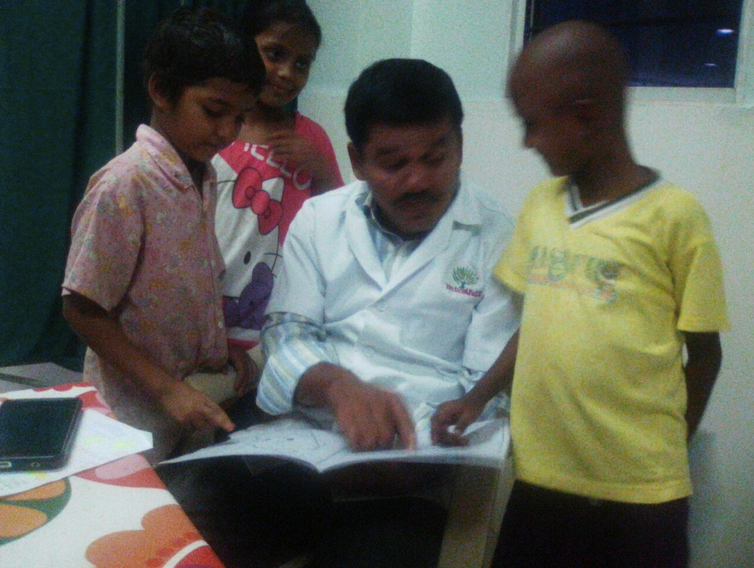
“We believe that no child should suffer or forget how to laugh and play”

Slide 31
Service Delivery
Home care service networks supported by specialized teams together with temporary residential alternatives offer the most effective, efficient and viable palliative care solution for children and their families
European Association of Palliative Care Taskforce for Palliative Care in Children, IMPaCCT: standards for paediatric palliative care in Europe. European Journal of Palliative Care, 2007; 14:2-7.

Slide 32
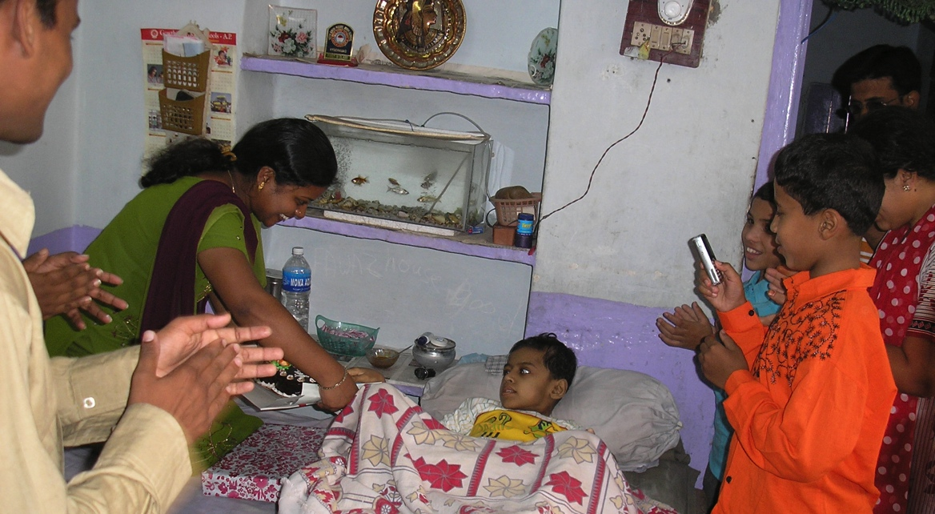
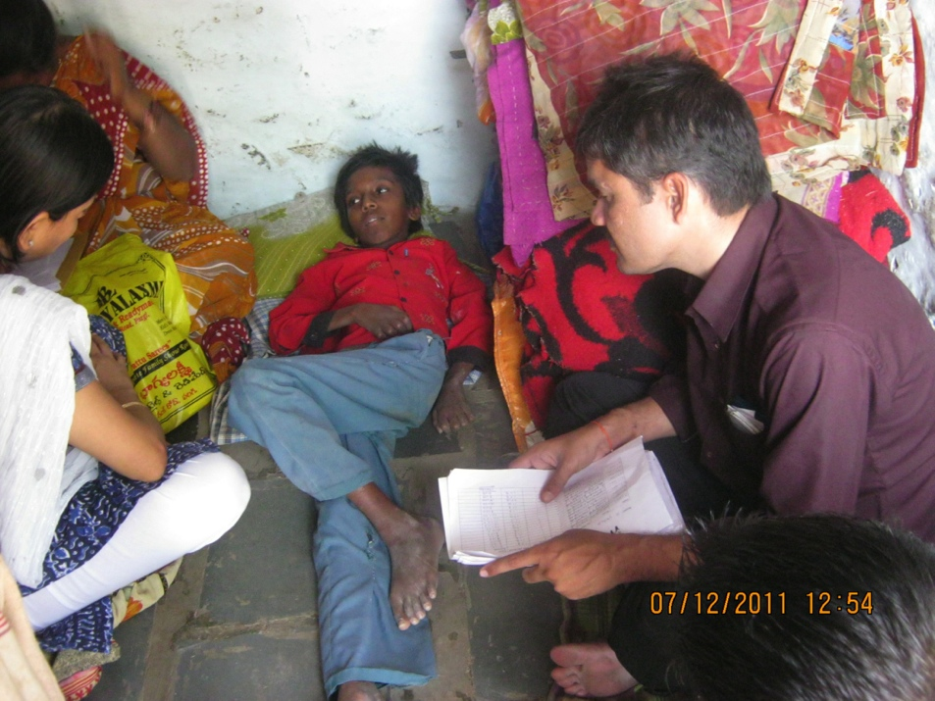
Home care
It is what children and most families want

Slide 33
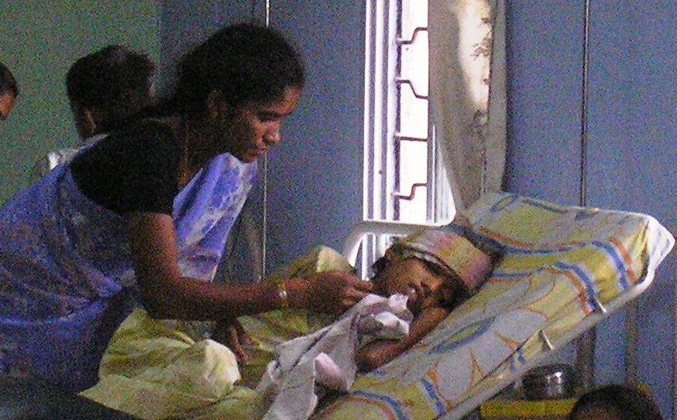
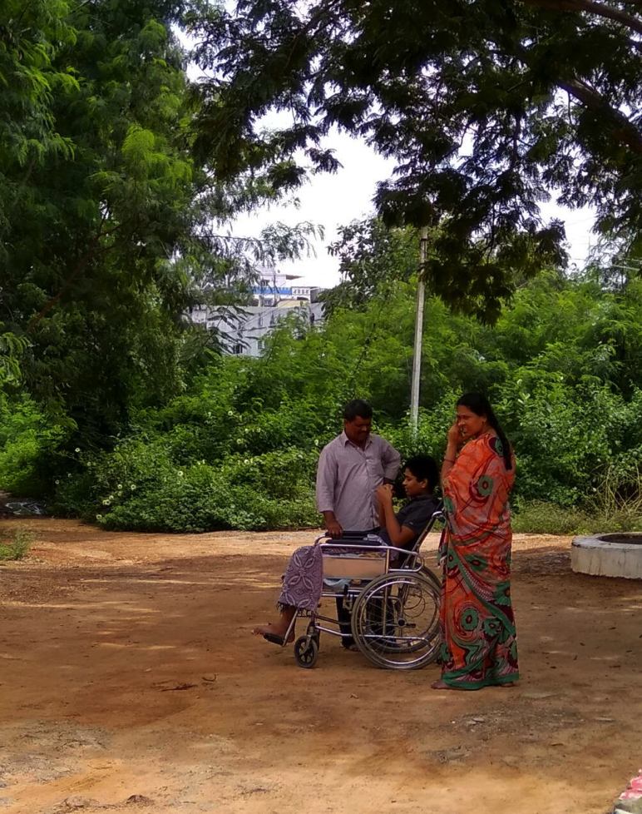
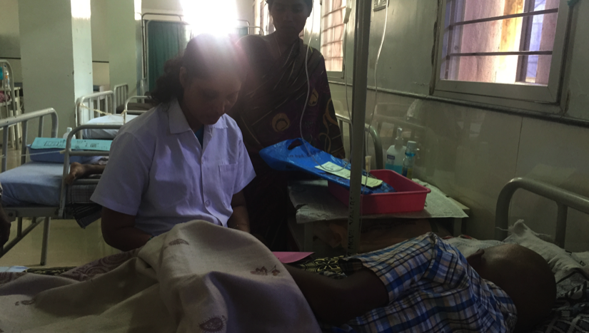
Hospice Care

Slide 34
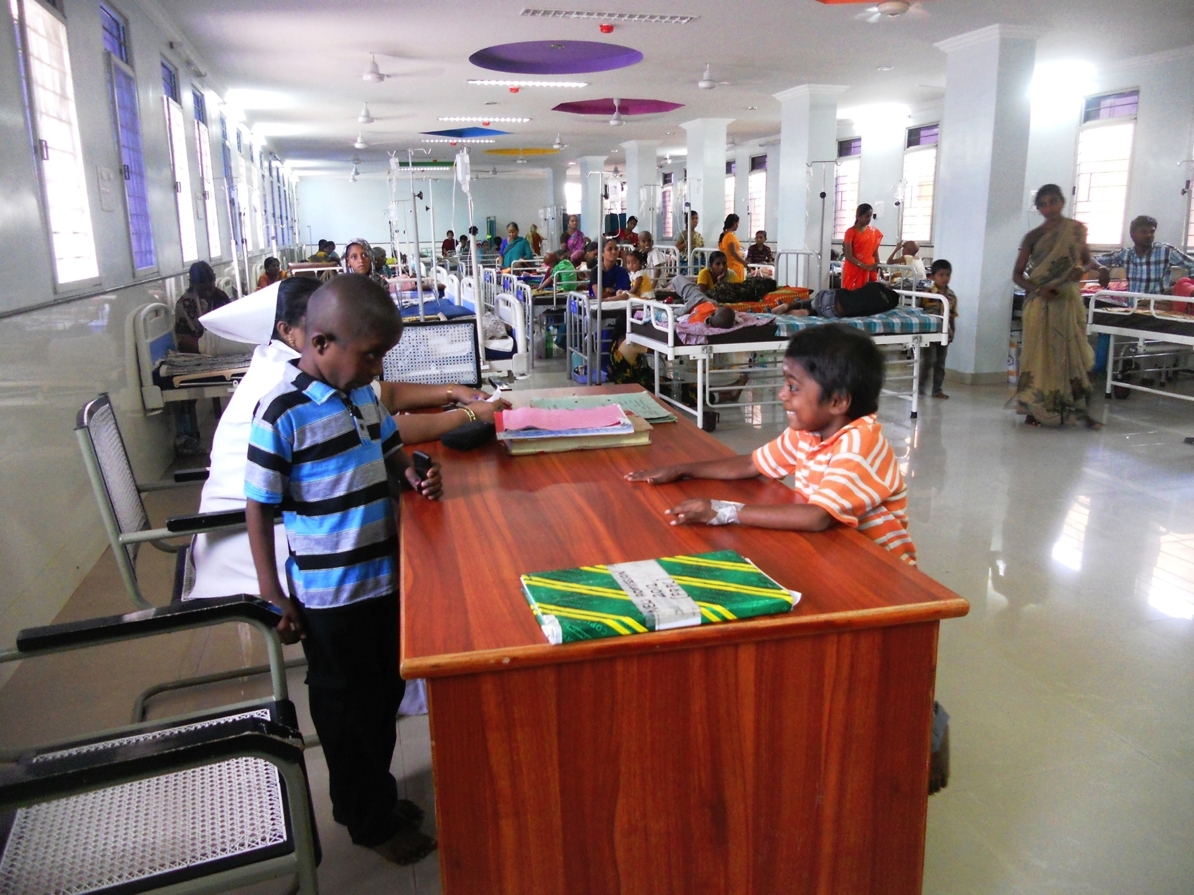
Outcome

Slide 35
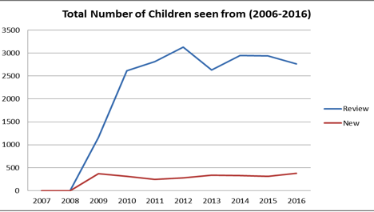
Children Seen in MNJIO (2006-2016)

Slide 36
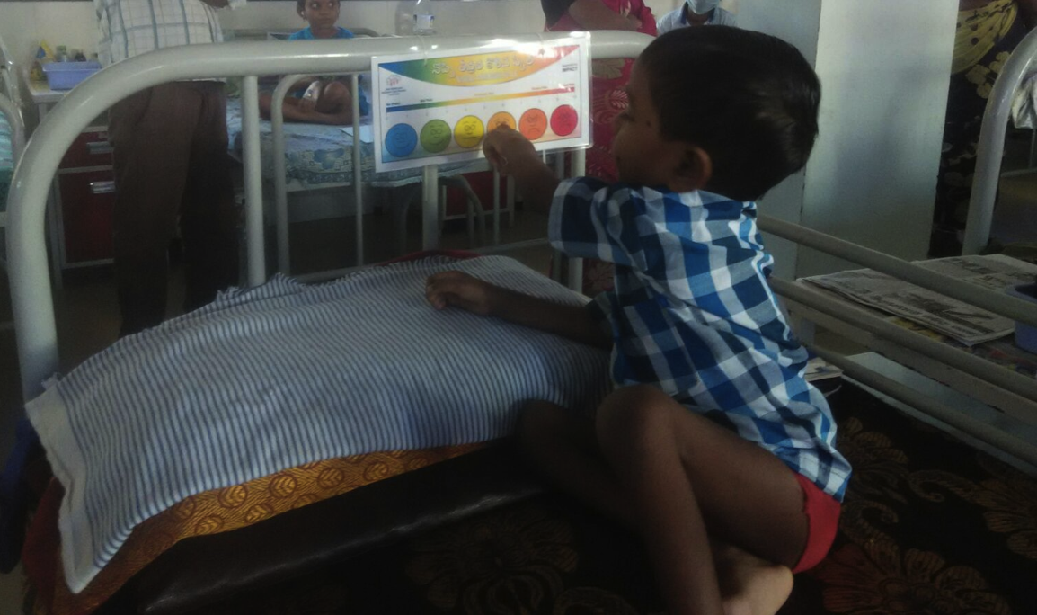
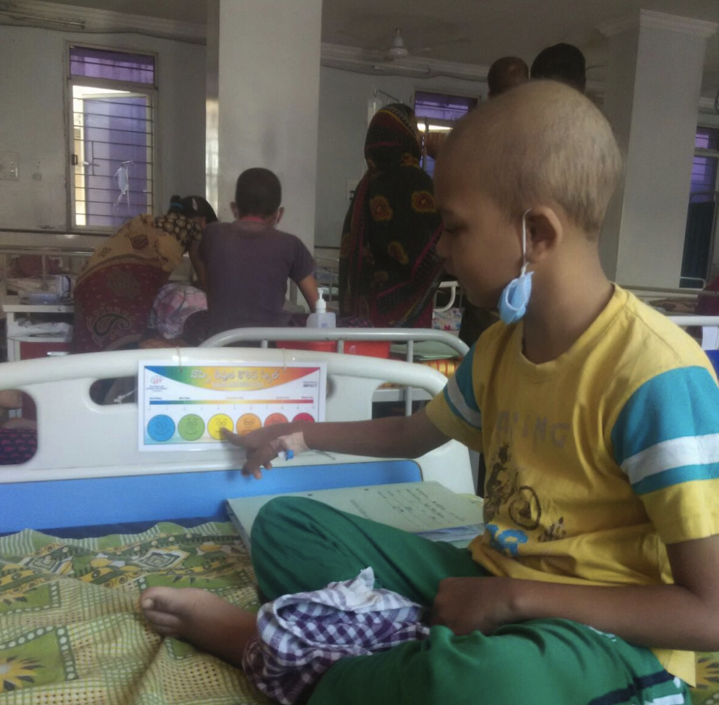
Routine Pain Screening

Slide 37
…Outcome
A center with high opioid Usage in children – an indicator of an effective pain relief program

Slide 38
Procedure- related Pain
Finger prick
Venipuncture
Injection
Lumbar puncture
Bone marrow aspiration and biopsy

Slide 39
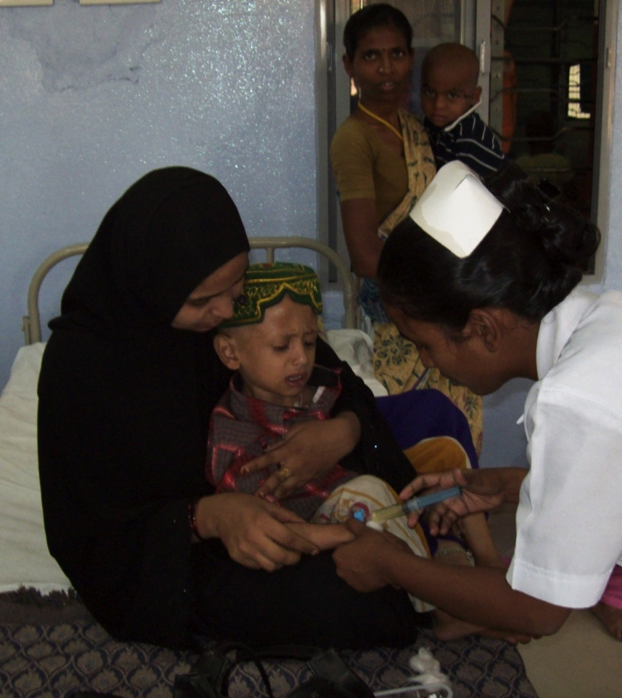
Procedure- Related Pain
Most painful and traumatic events experienced
EMLA Cream
Conscious sedation
General anesthesia
Notes:
Although procedure-related pain represents an acute, short-lived experience, it is accompanied by a great deal of fear and anxiety.

Slide 40
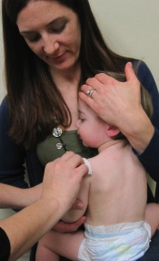

Positioning

Slide 41
file://localhost/Users/gayatripalat/Documents/videos/Video Intrathecal Counseling .m4v

Slide 42
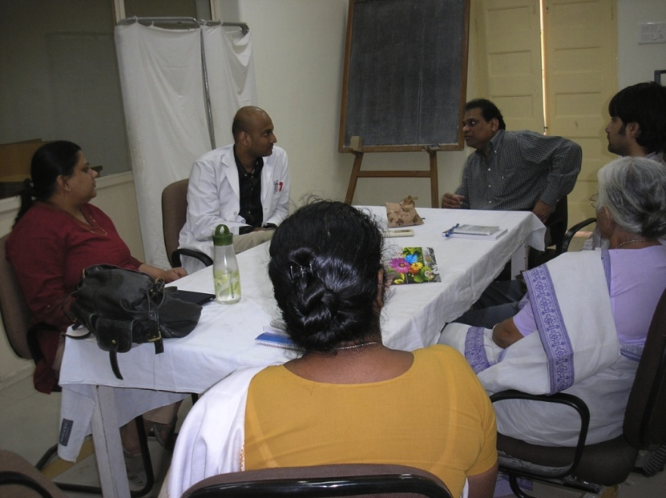
…Outcome
A pain sensitive hospital
A module on pediatric palliative care in all training courses
Workshops and sensitization programs
A Center of Excellence for
Pain and Palliative
Medicine Fellowship

Slide 43
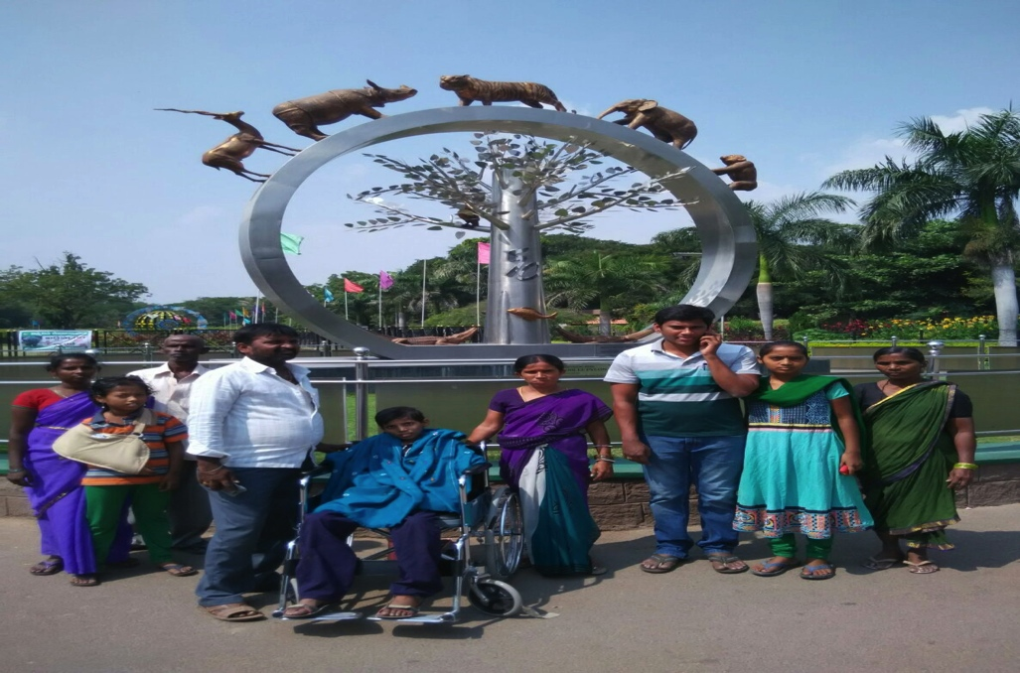
Last Wishes

Slide 44
Early Integration of Palliative Care into a Pediatric Oncology Program
  Improved the quality of life
  Sensitized oncology team -early identification of pain and distress
  Smoother transition to palliative and EOLC
  Reduced treatment abandonment with better chances of survival
.

